Slide 1
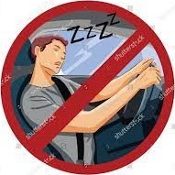
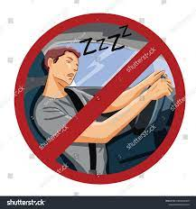
DRIVER DROWSINESS DETECTION
SYSTEM
GUIDE NAME:
Dr.R.Sheeba
ASP /CSE
TEAM MEMBERS:
Sridharshini A (8115U21CS106)
Limena A (8115U21CS066)
Swetha V (8115U21CS115)
Sneka R (8115U21CS105)

Slide 2
BASE PAPER
Topic:Detecting Driver Drowsiness Using Wireless Wearables.
Author Name:Warwick B, Symons N, Chen X & Xiong.
Reference:IEEE
Year:2020

Slide 3
OBJECTIVE
The purpose of the drowsiness detection system is to aid in the prevention of accidents passenger and commercial vehicles.
The system will detect the early symptoms of drowsiness before the driver has fully lost all attentiveness and warn the driver that they are no longer capable of operating the vehicle safely.

Slide 4
SS
ABSTRACT
The major aim of this project is to develop a drowsiness detection system by monitoring the eyes.
In such a case when drowsiness is detected, a warning signal is issued to alert the driver.
The system also has additional feature of slowing down the vehicle if driver fails to respond to the alarm and ultimately stops the vehicle.
We propose an algorithm to locate, track, and analyze both the drivers face and eyes to measure PERCLOS, a scientifically supported measure of drowsiness associated with slow eye closure.

Slide 5
INTRODUCTION
Machine learning (ML) is a branch of artificial intelligence (AI) that enables computers to “self-learn” from training data and improve over time, without being explicitly programmed. Machine learning algorithms are able to detect patterns in data and learn from them, in order to make their own predictions.
Driver drowsiness detection is a car safety technology which helps prevent accidents caused by the driver getting drowsy. Various studies have suggested that around 20% of all road accidents are fatigue-related, up to 50% on certain roads.

Slide 6
LITERATURE REVIEW
S.NO | AUTHOR | JOURNAL | DESCRIPTION | ADVANTAGES | DISADVANTAGES
1 | D. Taherkhani | IEEE | An Accurate Morphological Drowsy Detection | Alert the driver while drowsy using sensor | Low accuracy
2 | D. Liu, P. Sun, Y. Xiao | ETCS | Drowsiness Detection Based on Eyelid Movement | When the developed model applies with the real time camera, the drowsiness can be detected considerably | As a result, they found 88% accuracy without glass, and a glass System detects 85% accuracy.
3 | Dr.K.S.Tiwari et al | IJERT | A study to identify drowsiness detection with IOT technology | A buzzer and camera placed with a microcontroller continuously monitor the drowsiness | It is not detect with glass.

Slide 7
ISSUES IN EXISTING SYSTEM
Night driving conditions or glasses, etc is not supported.
Real-time face recognition is not supported.
In dark condition, system is not worked properly.

Slide 8
PROBLEM STATEMENT
Many of the accidents will occur due to drowsiness of the driver.
Hence drowsiness can be detected by monitoring the driver through continuous video stream with a camera.
The general objective is to create a model that will indicate whether a person is feeling drowsy or not.

Slide 9
PROPOSED SYSTEM
Drowsiness detection system is the architecture for detecting the drowsiness of the driver. First of all the system captures images through the webcam and after capturing it detects the face through haar cascade algorithm. It uses haar features which can detect the face. If the system founds it as face the it will proceed for next phase i.e eye detection. The eye is also detected using haar cascade features and it is used for blink frequency. The state of eye will be detected using PERCLOS algorithm. Through this algorithm we can find the percentage of time the eye lids remains closed. If it found eyes in closed state then it detects driver in drowsy state and alerts him by an alarm. The drivers face is analyzed continuously to detect any distraction. If found then alarm is activated by the system.

Slide 10
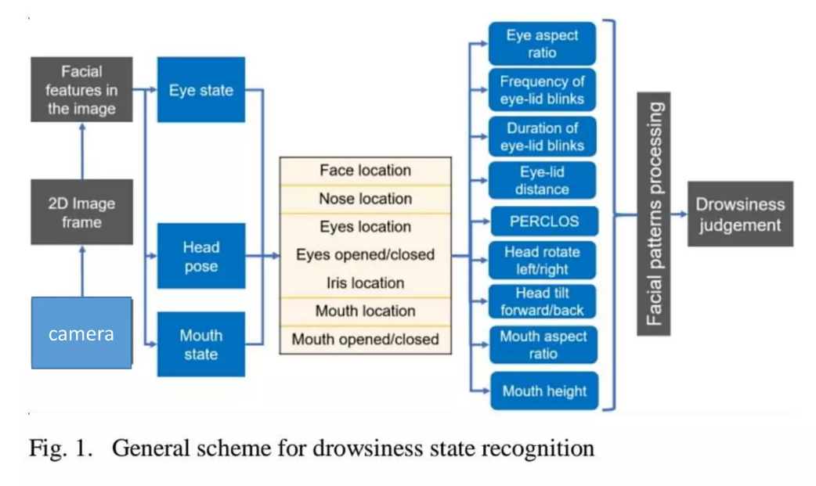
SYSTEM ARCHITECTURE
Alert

Slide 11
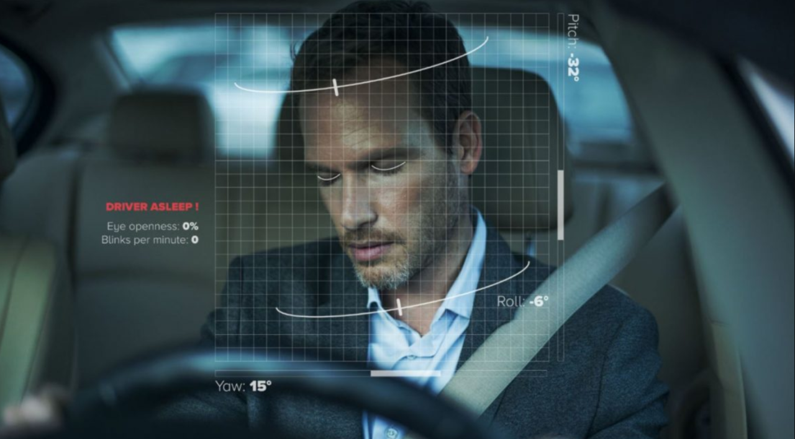
LIST MODULES
MODULE 1:
Take Image as Input from a Camera :
With a webcam, we will take images as input. We use the method provided by OpenCV to access the camera and set the capture object.

Slide 12
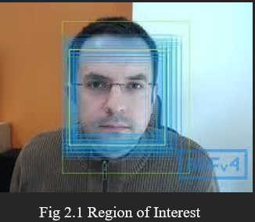
MODULE 2:
Detect Face in the Image and Create a Region of Interest (ROI):
To detect the face in the image, we need to first convert the image into grayscale as the OpenCV algorithm for object detection takes gray images in the input. We will be using haar cascade classifier to detect faces. Now we can iterate over the faces and draw boundary boxes for each face.

Slide 13
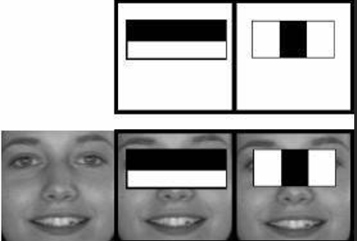
MODULE 3:
Detect the eyes from ROI and feed it to the classifier:
The same procedure to detect faces is used to detect eyes. First, we set the cascade classifier for eyes in left eye and right eye respectively. Now we need to extract only the eyes data from the full image.This will be fed into our CNN classifier which will predict if eyes are open or closed. Similarly, we will be extracting the right eye.

Slide 14
MODULE 4:
Classifier will Categorize whether Eyes are Open or Closed:
We are using CNN classifier for predicting the eye status. To feed our image into the model.Then, we resize the image to as our model was trained on 24-24 pixel images.We loaded our model. Now predict each eye with our model using predict classes, if the value of Ipred[0]=1 then, it states that eyes are open, if value of Ipred[0]=0 then, it states that eyes are closed.

Slide 15
MODULE 5:
Calculate Score to Check whether Person is Drowsy :
The score is basically a value we will use to determine how long the person has closed his eyes. So, if both eyes are closed, we will keep on increasing score and when eyes are open, we decrease the score. A threshold is defined for example if score becomes greater than 15 that means the person's eyes are closed for a long period of time. Then the alarm will be raised.

Slide 16
ADVANTAGES
OpenCV based machine learning techniques are used for automatic detection of drowsiness.
Bounding box creation and tracking.
Region of interest is clear to identify.

Slide 17
CONCLUSION
The driver abnormality monitoring system developed is capable of detecting drowsiness, drunken and reckless behaviour of driver in a short time.
Driver monitoring system works well even in case of drivers wearing spectacles and even under low light conditions if the camera delivers better output.

Slide 18
FUTURE WORK
The future works may focus on the utilization of outer factors such as vehicle states, sleeping hours, weather conditions, mechanical data, etc… for fatigue measurement.
Currently there is not adjustment in zoom or direction of the camera during operation.
Future work may be to automatically zoom in on the eyes once they are localized.

Slide 19
REFERENCES
Garcia, S. Bronte, L. M. Bergasa, J. Almazan, and J. Yebes, (2020). “Vision- based drowsiness detector for real driving conditions,” IEEE Intelligent Vehicles Symposium,Proceedings.
Sukrit Mehta, Sharad Dadhich, Sahil Gumber, Arpita Jadhav Bhatt (2020). Real- Time Driver Drowsiness Detection System Using Eye Aspect Ratio and Eye Closure Ratio International Conference on Sustainable Computing in Science, Technology and Management.
http://dlib.net/face_landmark_detection_ex.cpp.html.
https://en.wikipedia.org/wiki/Driver_drowsiness_detection.

Slide 20
THANK YOU

